Slide 1

Title of the Project: MANIFACTURE Analytics
Project Supervisor : Dr.J.JABEZ ,Professor CSE
Name of the Students: VIGNESH.S,RT.VIGNESWARI Register Number : 41111363, 41111364

Slide 2
Presentation Outline
Introduction
Objectives
System Architecture / Ideation Map
Application Snapshots
Results and Discussions
Conclusion & Future work
References

Slide 3
Introduction
Manufacturing analytics leverages data analysis tools to optimize production processes, enhance efficiency, and drive innovation.
By harnessing data from sensors and production systems, manufacturers can identify patterns, trends, and anomalies to inform decision-making.
From predictive maintenance to supply chain optimization, manufacturing analytics empowers companies to reduce costs and maintain a competitive edge in the market.
Key Objectives :
Improve Operational Efficiency
Enhance Quality Control
Enable Data-Driven Decision-Making

Slide 4
Objectives
OBJECTIVE The manufacturing analytics is to leverage data-driven insights to optimize every facet of the production process, from operational efficiency and quality control to predictive maintenance and supply chain management.
Enhance operational efficiency : optimizing production processes, reducing downtime, and minimizing resource wastage through data-driven insights and analysis.
Improve product quality and reliability : identifying and addressing defects, deviations, and inconsistencies in manufacturing processes, thereby enhancing customer satisfaction and brand reputation.

Slide 5
System Architecture/ Ideation Map
Data sources
Data storage
Data processing
Data Visualization and Reporting
Department of CSE

Slide 6
Project Implementation
1.Data Collection and Integration:
Identify relevant data sources including sensors, IoT devices, and production systems to gather real-time operational data.
Implement data collection mechanisms and standardized formats to ensure seamless integration of diverse data streams.
Analytics Model Development:
Identify the most relevant features (variables) from the dataset that are predictive of the desired outcomes. This helps in reducing dimensionality and improving model performance.
Choose appropriate machine learning algorithms or statistical models based on the nature of the problem and available data. Common models for manufacturing analytics include regression, classification, clustering, and time series forecasting models.
3. Dashboard and Report Development:
Identify Key Performance Indicators (KPIs): Determine the most relevant metrics and KPIs for monitoring and evaluating manufacturing performance, such as production efficiency, equipment downtime, quality yield, and inventory levels.
Design Dashboard Layout: Create a dashboard layout that visually represents the selected KPIs and provides an intuitive user interface for users to interact with the data. Consider factors such as data visualization techniques, layout design, and usability principles.

Slide 7
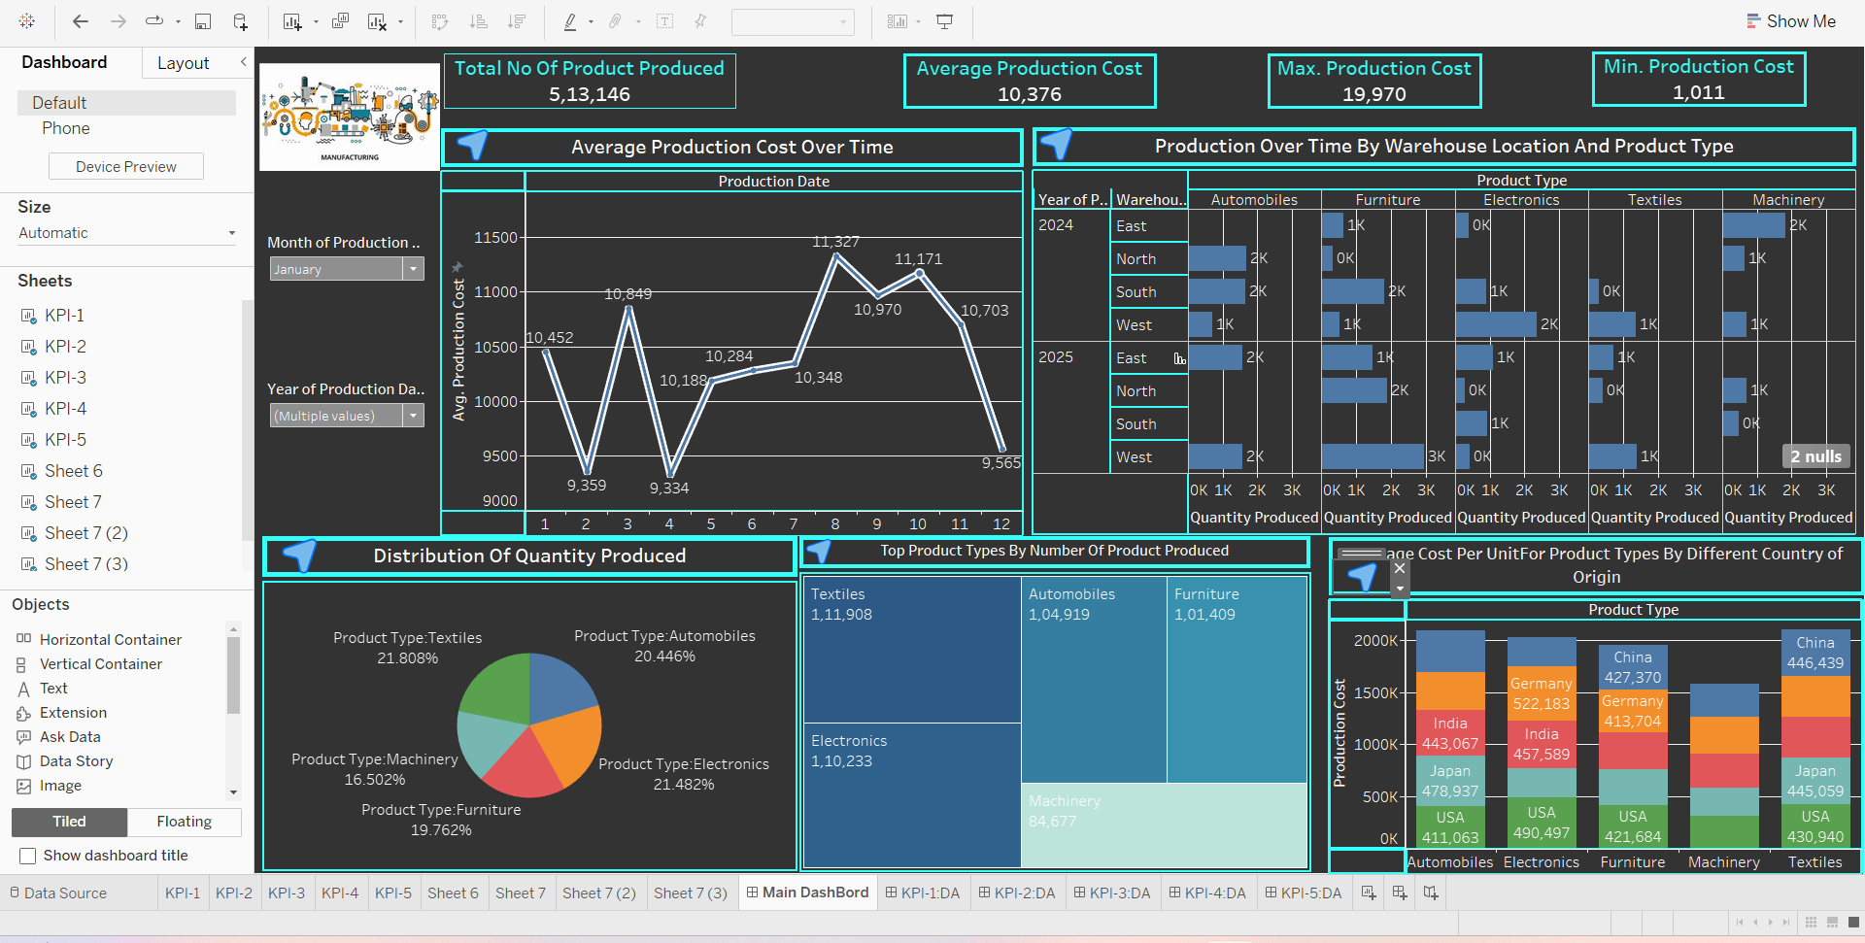
Sample Snapshot

Slide 8
Results and Discussion
The results of the Manifacture analytics project provide valuable insights for the business:
Impact on Operations: Discuss how the findings from the analysis impact manufacturing operations. Highlight any areas of improvement identified, such as opportunities to optimize production processes, reduce costs, improve product quality, or enhance supply chain management.
Predictive Insights: If predictive analytics were used, discuss the predictive insights obtained from the analysis. This may include forecasts of equipment failures, demand forecasts, or predictive maintenance schedules. Assess the reliability and accuracy of the predictive models and their potential impact on operations.

Slide 9
Conclusion
Manufacturing analytics can help manufacturers to identify areas where their operations can be improved. This can lead to increased efficiency and reduced costs.
Manufacturing analytics can help manufacturers to predict when machines are likely to fail. This allows them to schedule preventive maintenance and avoid unplanned downtime.
By improving product quality and efficiency, manufacturing analytics can help manufacturers to improve customer satisfaction.

Slide 10
References
Websites and Blogs:
Kaggle (www.kaggle.com): Kaggle offers datasets, competitions, and kernels (code notebooks) related to Manifacture analytics.
Books:
Bhatt, C.; Kumar, I.; Vijayakumar, V.; Singh, K.U.; Kumar, A. The state of the art of deep learning models in medical science and their challenges. Multimed. Syst. 2021, 27, 599–613.
3. Research Papers:
Mori, M.; Kubota, K.; Oyama, J.; Yamaga, E.; Yashima, Y.; Katsuta, L.; Nomura, K.; Nara, M.; Oda, G.; et al. The Utility of Deep Learning in Breast Ultrasonic Imaging: A Review. Diagnostics 2020, 10, 1055

Slide 11
THANK YOU

